Slide 1

Scientific Paper Writing II
Scientific Communication
Dr M. Hassan
Faculty of Geosciences & Environmental Engineering
Southwest Jiaotong University

Slide 2
Before writing process!
Select a Target Journal Early in the Writing Process
Identify Author Roles Early in the Process
detailed roles, such as who will:
-draft each section of the manuscript,
-submit the paper electronically,
-serve as corresponding author, &
-write the cover letter.

Slide 3
Structure of Scientific Papers
Order of core sections of academic research articles
Title page
Abstract
Introduction
Materials and Methods
Results
Discussion
References
There are other formats depending on the specific Journal
IMRaD Format

Slide 4
Section | Details
Introduction | Provides context by explaining how the hypothesis was derived and how it connects to previous research; gives the purpose of the experiment/study
Methods | Clarifies how you tested the hypothesis and why you performed your study in that particular way
Results | Explains how the data were evaluated; shows calculations, expresses the data in table form or as figures where needed
Discussion | Interprets your results and discusses the implications of your findings; states potential limitations of your experimental design

Slide 5
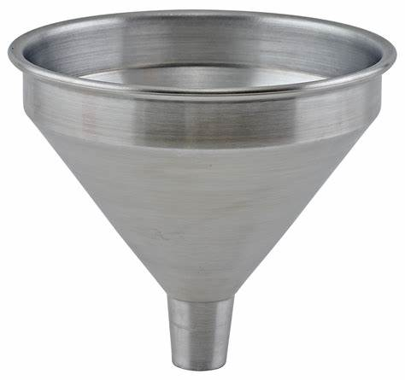
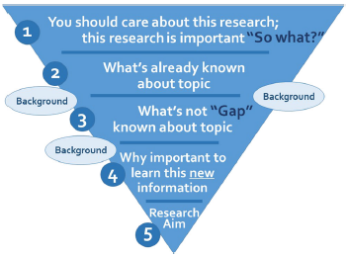
Introduction section
Structure of the Introduction Section
Funnel model
The broadest part at the top (beginning) represents the general context of the study topic.
three to five paragraphs in length.
First paragraph: highlight general background stressing the magnitude & importance of the problem.
Second paragraph: summarize what is already known
Third paragraph: what is not known (study gap) and its importance.
Fourth paragraph: aim (objective) of the study or research question or hypothesis and explain briefly what you have done to answer this question.
-Multiple aims: specify the primary aim & address the secondary aims in a separate sentence.
Fig. 1： Main elements of introduction section of an original
research article.

Slide 6

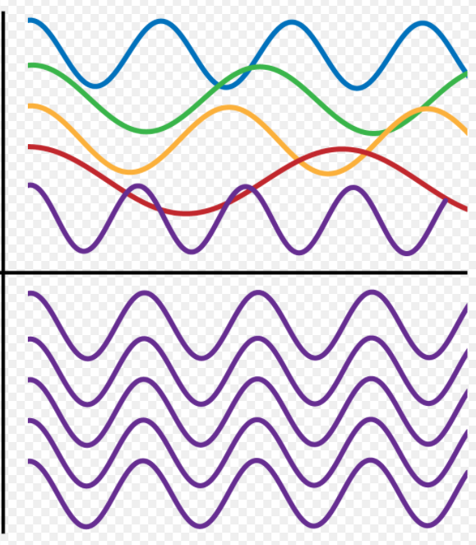

Introduction…. Cont..
Common mistakes:
1. Lengthy introduction:
It should not exceed 10–15% of the total article.
2. Lack of coherence: Between paragraphs & between sentences
3. Too little or too many citations:
Provide a reasonable number of citations.

Slide 7

Checklist for the introduction
Check if the introduction has a funnel shape with clear sections on:
-general background (what is this all about?);
-what is known and what is unknown about this specific subject
-(why was this study needed, and why is it important?);
-primary research question (what did we want to know?);
-study aim and design (what did we do to answer the research question?)
Look at the introduction length (maximum 10-15% of the total word count).
Ask yourself, ‘‘Will this introduction sell my paper to editors, reviewers, readers, and the media?’’

Slide 8

Materials & Methods Section
Paper’s methods section would be like a food recipe
It describes the methods & means used to conduct the study
how you gathered and sorted through all the necessary data
has to be very specific and comprehensive
section is important since it shows how you came to your results
if you applied non-standard methods this is the place to explain
if you adapted existing methods, explain here
It is the link between the Introduction & Results sections.

Slide 9
Materials & Methods.. Cont..
Basic elements:
Study design & setting; time period/location
Participants − inclusion and exclusion criteria
Ethical approval
Protocol of the study
Data collection
Sample size calculation
Methods of data analysis

Slide 10
Checklist for the methods section
Include basic information on study design, setting and subjects, data collection, data analysis, and ethical approval
Refer to previous publications from the same large research project, such as a study protocol, for additional information (if applicable)
Consider providing detailed information on the methods as web only supplementary materials.
Ask yourself, ‘‘Would a researcher be able to reproduce the study with the information I provide in this paper?’’

Slide 11

Results section
What should you know?
Aim: to describe what you observed
The findings are presented without interpretation.
No citations in the results section
Results section mirrors the Materials & Methods section
-For every method (what you did), there should be a corresponding result (what you found).
Results section is a dynamic interplay between text and figures/tables.
Tables & figures are particularly useful to present larger quantities of data

Slide 12
What should you do?
Findings in the results section should match & answer the research questions from the introduction, using the procedures explained in the methods section.
Tables should be used for data such as baseline characteristics, outcomes, treatments, where the same variables are being described for two or more groups.
Figures are useful when the source data is either too complex for presentation or not easily interpretable.
Do not repeat data in the text that already appears in a table or figure.
Limit to the total number of figures and tables… check for journal guidance before including too many.
Primary analysis should be presented in a separate paragraph.
Secondary results (post-hoc analysis) should be given separately.
Report your non-significant associations. These are still findings.

Slide 13
Checklist for the results section
Structure roughly into: recruitment/response, sample characteristics, primary analyses, secondary analyses, & ancillary analyses.
Match the results section with the methods section.
Present findings without interpretation.
Highlight findings from tables and figures in the text.
Present estimates with 95% confidence intervals.
Consider providing additional results in tables and figures as web only supplementary material.

Slide 14
Table and figures
Make a deliberate choice early in the writing process on which key findings to present in tables/figures.
The title should reflect what is shown.
Ensure that tables/figures are self-explanatory.
Do not repeat information from tables/figures in the text but emphasize the important findings.
Design tables/figures to make them clear and easy to read.
Start each table/figure on a new page, after the reference list.

Slide 15
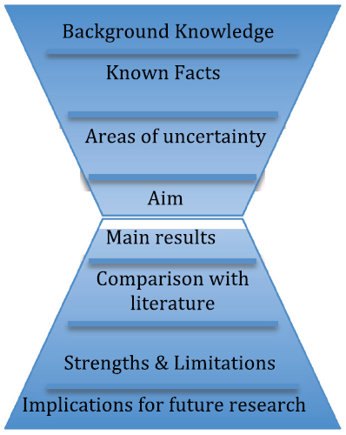
Discussion section
Purpose: to give a summary of the main findings & compare with previous work & discuss future implications & any shortcomings of the research design.
Discussion can be visualized as an inverted funnel.
Thus, the introduction & discussion together form an hourglass shape.
Discussion starts with the narrowest part by answering the research question and it then gradually widens out to comparisons with other studies

Slide 16
Discussion section.. Cont..
discuss and analyze results of your research
do not introduce new ideas in this section
Write the discussion by imagining yourself in a dialog with an interested reader
Do not ignore or cover up inconvenient results.
Always stick to the original storyline of the paper.
go beyond the result section – discuss possible implications of your research
what further research should be done, based on your results
what is the Unique Selling Point of your approach,
what are possible limitations
End the discussion section with a conclusion presenting your findings in light of the evidence in the field

Slide 17
Checklist for the discussion
Check if the discussion has a clear inverted funnel shape with distinct sections providing:
-A summary of main findings (What did we find?);
-Comparisons with other studies (What is known?, What is new?, and How does this fit in?),
-Strengths and limitations (Are the findings true?
-Implications (Are the findings important? What can we do with them?).
Answer the research question in the first paragraph and check if this is in line with the research question posed in the introduction (hourglass model).
Check to see if the discussion section does not present new results.
Be frank about acknowledging limitations.
Ensure it offers a clear ending to the storyline of the paper (citable statement).
Formulate a clear and concise one-liner as the bottom line of the paper.

Slide 18
Title of the manuscript
The title of a manuscript gives the first impression about the manuscript.
A comprehensive title may have the following three important keywords:
-general, indicating the area or specialty the article belongs to
-intermediate, referring to a specific disease or condition; &
-specific, referring to particular tests or interventions.
Abbreviations should be avoided unless they are very well known (e.g. DNA).

Slide 19
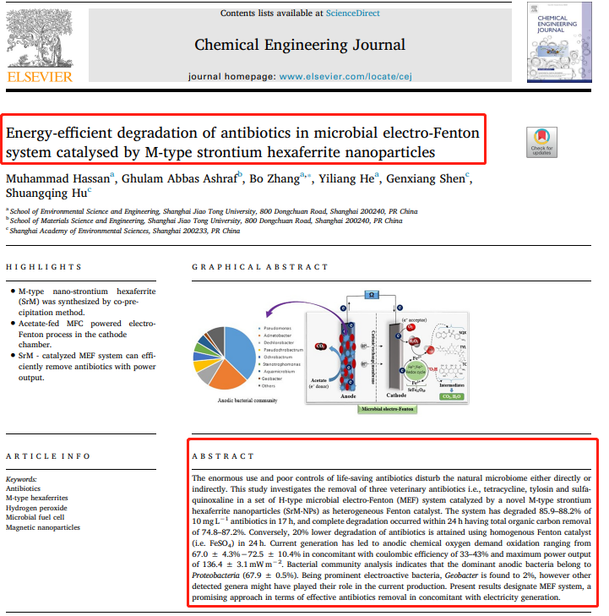
Abstract
Abstract may influence the editors, peer reviewers, & readers about the manuscript quality
Word limit: 100-250 words
Key components:
1. Background
A brief reminder of the context, and a brief statement of the main objective.
Should be short and to the point.
Two to three sentences are generally sufficient
Identify the gap in knowledge that you hope to fill

Slide 20
2. Methods:
The main methods should be outlined:
- The main inclusion criteria to define the population
- Define the study groups, if any
- Describe (very briefly) the main interventions or treatments
- State the primary endpoint

Slide 21
3. Results:
List the main results, with means, odds ratios, p-values, etc for each group.
List the result of the primary endpoint first, followed by secondary outcomes
Ensure that you have given a result for every method you mentioned in the methods section
There should be enough detail to back up your conclusion

Slide 22
4. Conclusion
A one-line conclusion summarizing your main finding is sufficient, with a short sentence implicating future research, if you have enough space
The conclusion should be directly related to the main objective and endpoint
No Discussion
No Tables/tables
No References

Slide 23

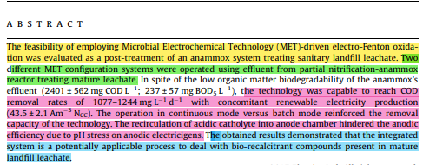
Background
Methods
Results
Conclusion

Slide 24
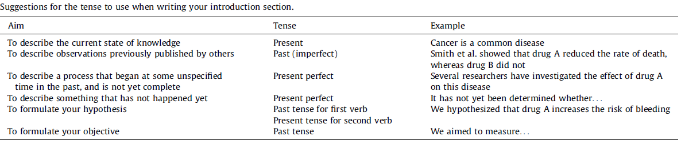
Use of tense in the manuscript writing
Section | Tense
Abstract | Present/past
Introduction | Present/past
Materials & Methods | Past tense
Results | Past tense
Discussion | Present/past
Ecarnot et al. 2015

Slide 25
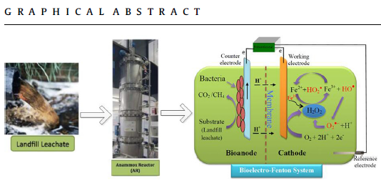
Graphical Abstract
It summarize the contents in a concise, pictorial form designed to capture the attention of a wide readership online & quickly gain an understanding of the take-home message of the paper.
The general standards for designing of the graphical abstract vary from one journal to another.
Cell magazine, the dimensions of the graphical abstract images should be 1200 by 1200 pixels with a resolution of 300 dpi
RSC, the size of the graphical abstract is very small (230 by 120 pixels).
A Graphical abstract is mandatory and/or
optional depending on journals.

Slide 26
Checklist for Title and abstract
Construct title and abstract from keywords from all sections of the main text.
Use important keywords at the beginning of the title.
Avoid abbreviations and passive voice (title and abstract).
Always state the objective and start the results section with the answer to the research question (abstract).
Give sample size if you report percentages (abstract).
Present effect sizes with confidence intervals (abstract).
Check if the abstract covers the 4 Ws:
1. Background: What is known and why is this study needed?
2. Methods: What did you do?
3. Results: What did you find?
4. Discussion: What does it mean?
Check that the abstract can be read independently from the main text.
Revise every time the main text is revised (title and abstract).

Slide 27
Authorship
Decide before you start writing Co-author = everyone that contributed significantly to research or design
Do not include people that only helped in writing or in collecting data
All co-authors should read and approve the final version
First author = contributed the most to the research
Last author = head of the laboratory
Corresponding author = did most of the writing and is usually, the first or last author

Slide 28
Authorship
Discuss authorship and develop a written authorship document (including lead authorship) at an early stage during a project.
Authors should have
(1) contributed substantially to the conception and design, acquisition of data, or analysis and interpretation of data;
(2) contributed to writing the paper or revising it critically for important intellectual content; &
(3) given final approval of the version to be published.
Ask coauthors to critically review & provide feedback with targeted questions & set them deadlines to respond.
Ask coauthors to meticulously check their names, initials, & affiliations before submitting.

Slide 29

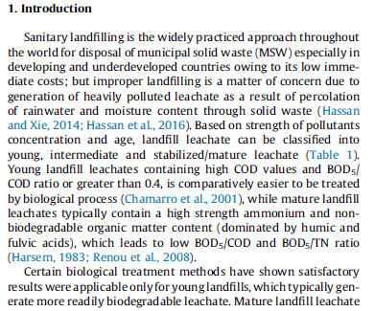
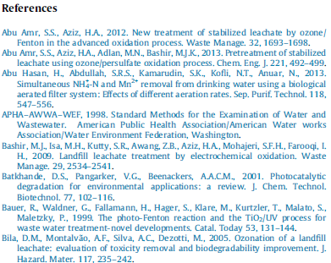
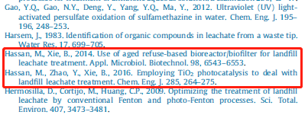
Citation
A "citation" is the way you tell your readers that certain material in your work came from another source.
Citations (In-text citation) can be used in Introduction and Discussion section.

Slide 30

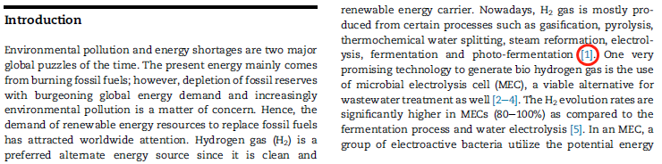
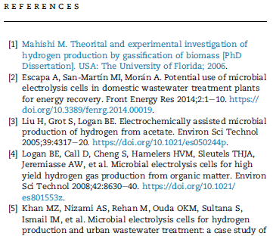
Citation

Slide 31
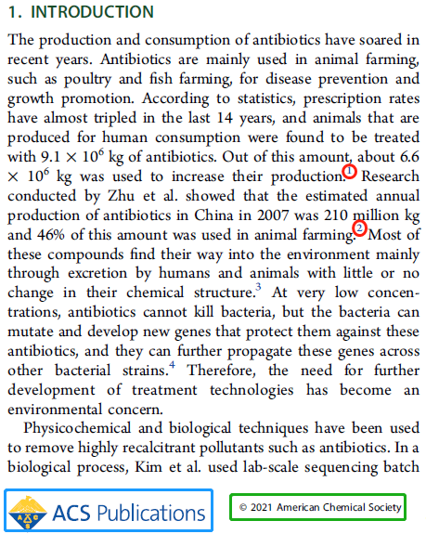
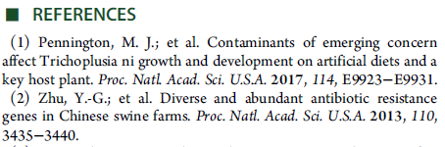
Citation

Slide 32
References
any idea or fact that emanates from another source (other than yourself) needs to be supported by a reference
The references support your work and place it in the context of other studies on the same topic
providing guidance for readers who would like to engage in further reading on the topic.
Citing sections from published books is also acceptable
Internet sites should be avoided where possible
the references style will vary according to your target journal
For original research manuscript, avoid too many refence list (not more than 50).

Slide 33
References
Use reference management software at all times (e.g. EndNote, Mendeley etc).
Find the requested output style in the author instructions of the target journal and adhere to it 100%.
Always cite the original source behind a statement.
Use your own words to describe facts derived from references, never copy paste sentences.
If you need to choose among several references, select one by considering the level of evidence, open-access, year of publication, and published in the target journal.
Precisely check the final reference list for errors.

Slide 34
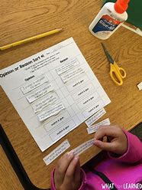

Class activity
Paper discussion
Paper writing (basic skills)

